Slide 1
Integration between services and mediation
Oxford University
Software Engineering Programme
December 2019

Slide 2
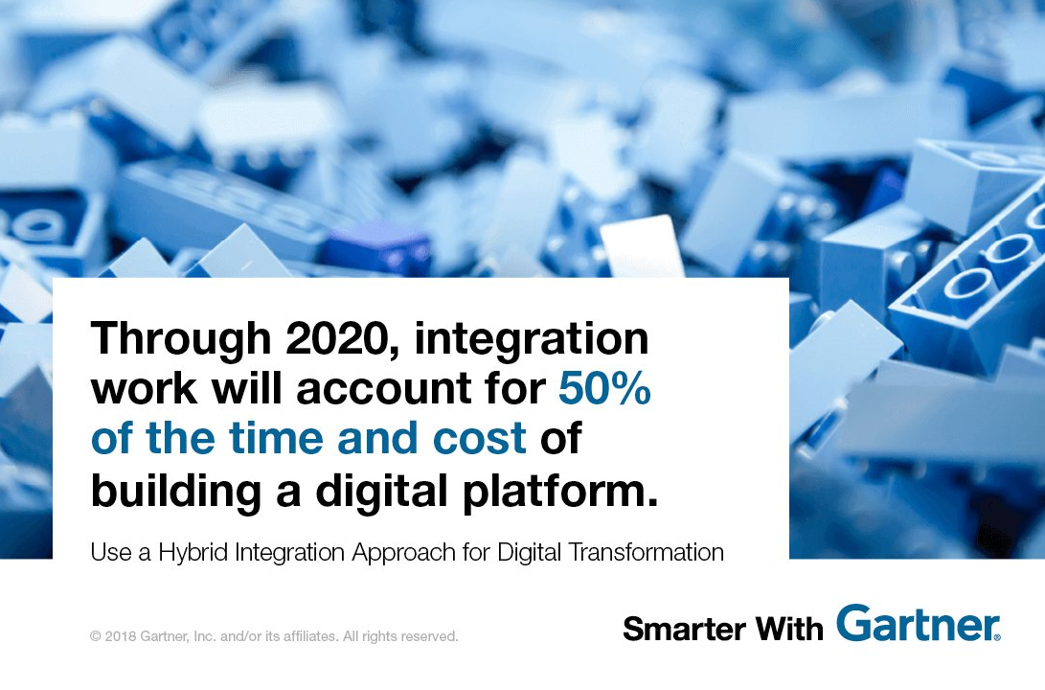

Slide 3
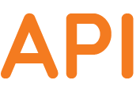
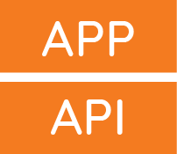


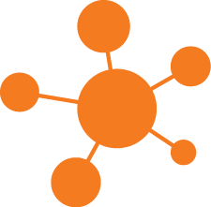
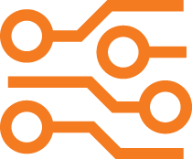
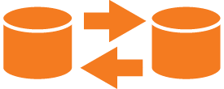
Seven Cases of Integration (from Gartner)
API Management
.
Digital Integration Hub
Application Integratio
Event Streaming
B2B Integration
IOT Integration
Data Integration

Slide 4

Recap on SOA model

Slide 5
Enterprise Service Bus (ESB)
A software architecture
A logical intermediary through which every message flows
Offers a policy based approach to decide what to do to each message or interaction
The benefits of the gateway model
Without a physical hub and spoke
Many vendors offer ESB products
Often a layer over an existing messaging framework

Slide 6
ESB as an implementation of SOA
Service
Service
Service
Contract
Contract
Contract
Enterprise Service Bus
Routing, Logging, Versioning, Transformation, Mgmt
Process
Management
Portal
Call Center

Slide 7
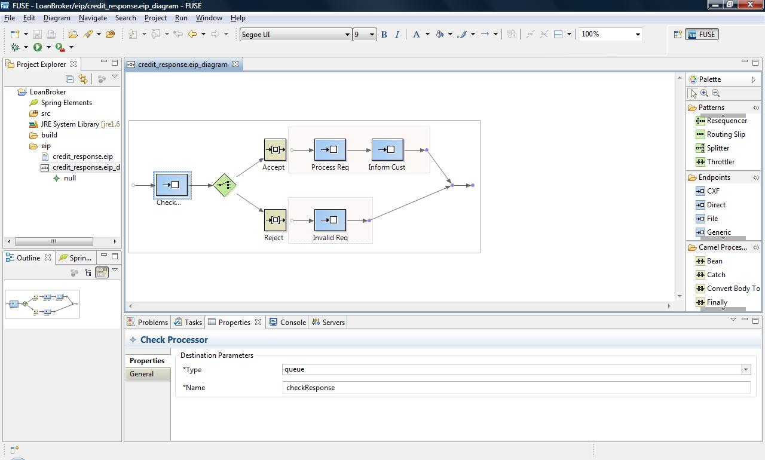

Slide 8
Fast Waterfall
“Wagile”
“Fagile”
App 1
App 2
. . .
App (n)
Centralized Dev Org
App Logic
App Logic
App Logic
INTEGRATION
Scaling
HA
Resilience
Observability
MESSAGING
Middleware & Integration CoE Teams
Scaling
HA
Resilience
Observability
Scaling
HA
Resilience
Observability
DATA
Scaling
HA
Resilience
Observability
Scaling
HA
Resilience
Observability
SECURITY
Scaling
HA
Resilience
Observability
HA
Resilience
Observability
Ops Team
Compute
Network
Storage
Ops Infrastructure
Notes:
As we adopt important pieces of middleware, such an ESB or a message broker, in order to scale, manage, and control them, we work to develop centers of excellence that have specialists in the domain. Our dev teams are then working in a mode where they must develop logic that is deployed within the middleware.
This creates not only a technology dependency, but it also creates an organizational dependency. Dev teams and the center of excellence invest in tools and other components so that the development team can work with the middleware locally with a lower dependency, but regardless there are many more gates. To move whatever software has been written now requires coordination across orgs and technologies. It’s rare that there is only a single piece of middleware, as development teams increasingly depend upon event-driven messaging systems, data warehouses, or databases.
This - in many ways - is one of the root causes of what it means to be waterfall. Your development team - your innovation engine, starts with an objective and they push the initiatives as far as they can and then work down the waterfall to each org and technology dependency until they eventually make it into operations.
VISUAL
** Introduce the slide talking about the fast waterfall mode of development**

Slide 9
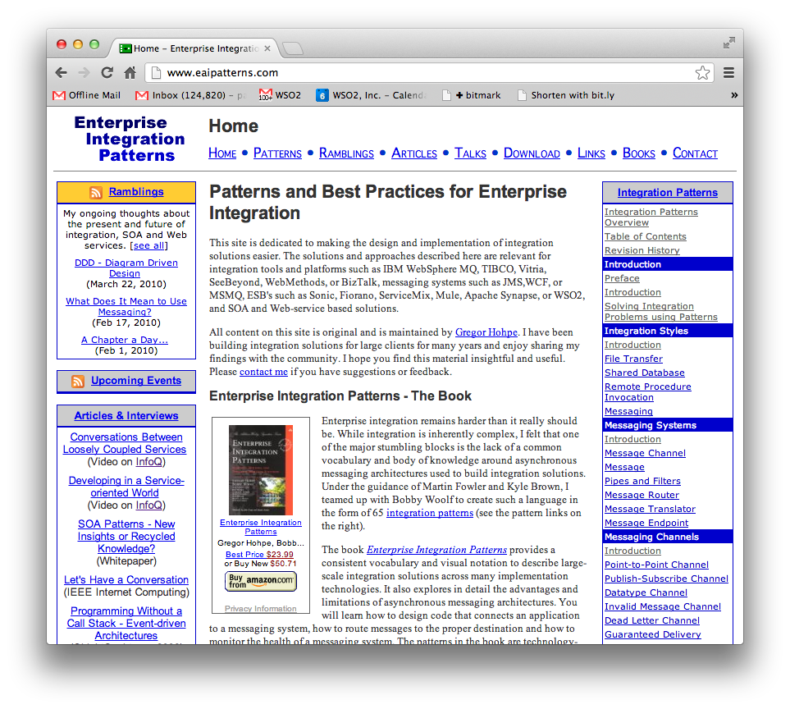
Enterprise Integration Patterns

Slide 10
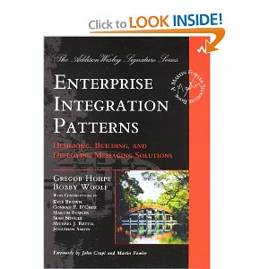
Enterprise Integration Patterns
http://www.eaipatterns.com/
The book
Enterprise Integration Patterns
Gregor Hohpe, Bobby Woolf

Slide 11
How does mediation / integration fit into Microservices / Containers?
“Smart Endpoints and Dumb Pipes”

Slide 12

Brownfield
Greenfield

Slide 13
Core
Systems
Disaggregated systems
Core
Systems
Core
Systems

Slide 14
Ballerina Language
A new integration language and framework for Microservices, RESTful SOA
Based on Swagger and Sequence Diagrams
Textual and graphical are 100% interchangeable
https://ballerina.io

Slide 15
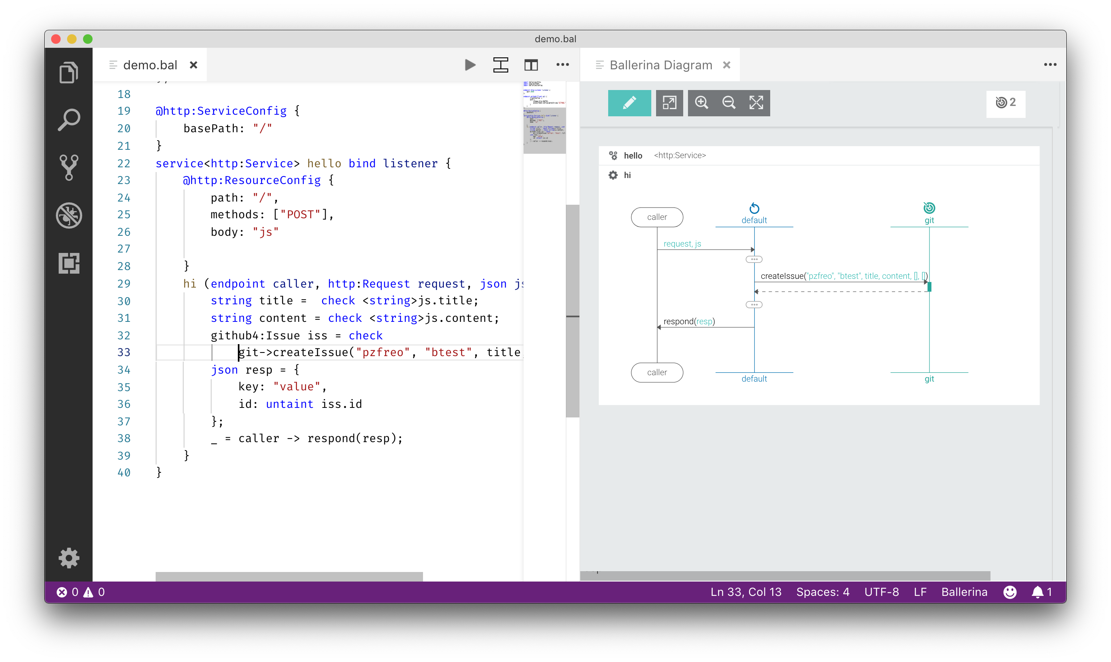
Ballerina diagram and language

Slide 16
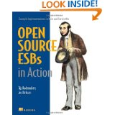
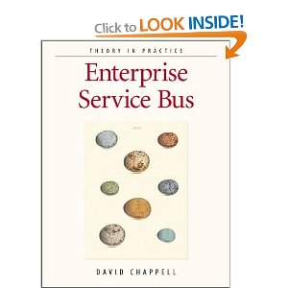
Resources
Wikipedia!
http://en.wikipedia.org/wiki/Enterprise_service_bus
Books
David Chappell: ESB
Open Source ESBs in Action
Open Source
synapse.apache.org
wso2.com/products/enterprise-service-bus
servicemix.apache.org

